Slide 1
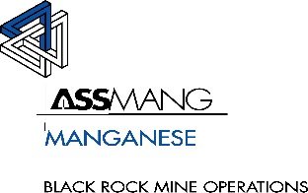
High & Low
Highlight | Lowlight
Average TMM Availability - 87% 54H Belt replacement. | Grizzly beam failure @ 74N Tip. UV0067 & 68 Brakes not releasing and engine cut off. SR0037 & 40 Brake unit failure and Fire suppression system activated. 9 West dam water supply to TNC. Communication failure on Plant operation. CAS 9 related problems on LDV’s (Nerospec)
Emerging Issues | Priorities
Plant labour Hydraulic Workshop out of planned labour to support TNC. | UV0128 Emulsion tank fitment. UV0068 Deutz Diesel Power to assist with engine cut off repairs. Underground dam inspections. CAS 9 Issues on Cruisers. Crushers gabs to be adjusted. On boarding of Mica Mining for dam cleaning.

